Slide 1
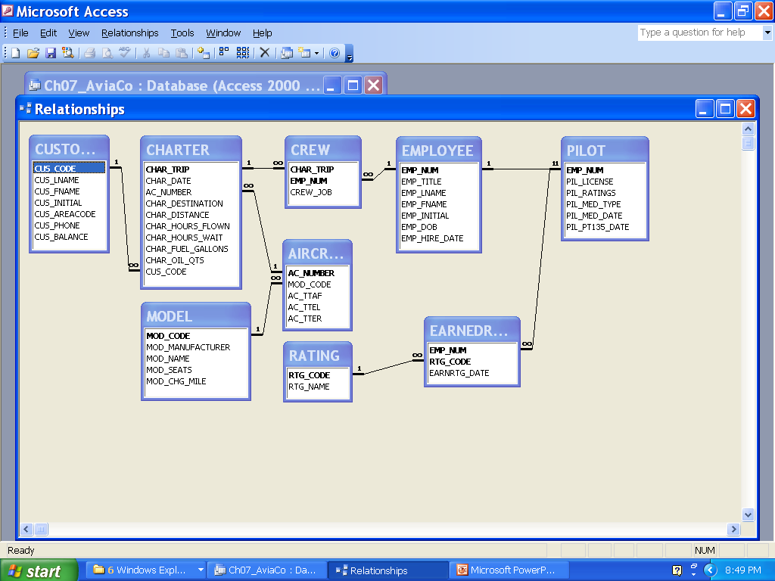
AviaCo. Database
# <number>

Slide 2
Consider
Show the charter trip number, date, and destination.
Which charters are using the aircraft 2778V?
What is the average hours flown by aircraft going to “ATL” – Atlanta?
How many flights are going to each city?
Which customers who went to ATL did not go to STL?
Which customers who went to ATL did go to STL?
Did any customers with an outstanding balance charter a flight on Feb. 5 or Feb. 6?
# <number>

Slide 3
Consider
How much is outstanding at the company?
What is the average charter distance?
Who crewed the TYS charters?
What are the names of everyone involved in the TYS charters?
What are the names of everyone involved in the TYS charters and their role (either CREW or PASSENGER)? Arrange the report by role with crew members first.
# <number>

Slide 4
Consider
What is the mileage charge for each flight flown after February 9? Note: “Charge per mile” is relative to the model; miles are an attribute of the charter.
    Show charter date, customer last name, charter distance, charge per mile, and mileage charge
    Arrange the above report so that the information displays dates in increasing fashion. Then, within dates, arrange by customer last name.
Produce a similar chart showing “gallons per mile flown”.
For the plane which flew the most miles, how old is its airframe, left engine, and right engine
For this heavily used plane, its travels in February accounted for what fraction of its airframe age?
# <number>

